Slide 1
A Synod Process
Gathering, listening, learning, planting, harvesting …

Slide 2
Delegates
Gather 350 or so delegates and bring them together in one place ….

Slide 3
Some 350 delegates drawn from all areas of Catholic faith in Limerick who have stepped forward for selection for the Synod attended the first event in preparation for the Synod itself at Mary Immaculate College on Saturday.

Slide 4
Prepare
Prepare and send delegates out to be hunter gatherers among the people of God in this place …

Slide 5
A gathering of all delegates took place on Saturday 31st January in The Limerick Radisson Hotel. The training was facilitated by Christopher Schoch, who is based in Clermont-Ferrand, France. Chris has designed and facilitated collaborative projects at different levels of Evry diocese including: revitalizing parish ministries, developing better collaboration, collaboratively planning a 5 year strategic plan, and launching interfaith dialogue.

Slide 6
Listen
Delegates to offer a variety of listening processes in their areas or ministry across the diocese …
…

Slide 7
Across this diocese over 5000 people engaged in discussion, surveys, on-line, in shopping centres, churches and schools.

Slide 8
Report back
Gather back the information – listen to whats coming in to see what emerges as priorities or themes …
… smoke signals!

Slide 9
On Saturday June 27th delegates gathered in Thomond Park. We were now coming to the end of the ‘See’ stage in which Listening has occurred to gather the issues of the people as expressed by the people.
The delegates have been actively engaged in a variety of methods of listening in their own communities. Parishes, schools, hospitals, universities and many other groups have used questionnaires, focus groups, informal listening and various other means to gather the views of people throughout the diocese.

Slide 10
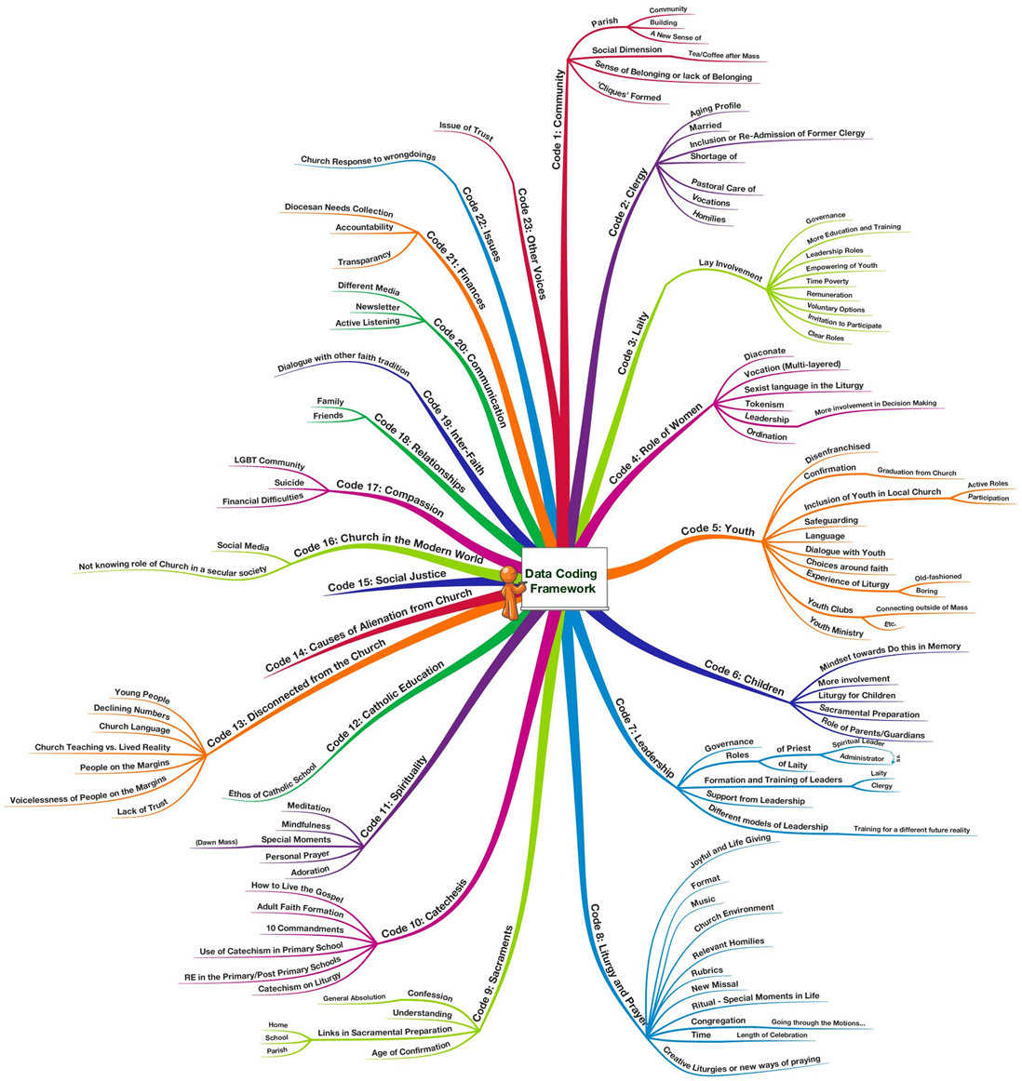
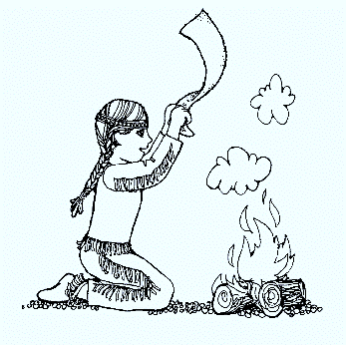
Discern
What’s emerging, what are people saying

Slide 11
October 2015 - A gathering of over 300 delegates – 70% of whom were lay people – to the Limerick Diocesan Synod, which takes place next year, selected the six themes from a shortlist of 12 compiled over a ‘Listening Process’ in the first half of 2015.
The process connected with 5,000 plus people, from primary school children to the elderly and drawn from all socio economic backgrounds and ethnicities, across the Diocese.

Slide 12
Broad to specific
How can we move from themes to aspirations and ideas. How can we make those ideas into concrete achievable proposals …

Slide 13
Spring 2016- a series of meetings across the diocese
Jan: invitation to create proposals
Feb: themed meetings to accept and refine proposals

Slide 14
Ideas – From the listening, according to theme, ideas rain down
Themes - Emerging from the listening, smoke signal to cloud!
Proposals – working on ideas, grounded in our experience and this process

Slide 15
Proposal
Proposal
Proposal
Proposal
Proposal
Proposal
Proposal
Proposal
Proposal
Proposal
THEME
Proposal
Proposal
Proposal
Proposal
Proposal
Proposal
Proposal
A jumble of proposals

Slide 16
Proposal
Proposal
Proposal
Proposal
Proposal
Proposal
Proposal
Proposal
Proposal
THEME
Proposal
Proposal
Proposal
Proposal
Proposal
Proposal
Proposal
Proposal

Slide 17
Proposal
Proposal
Goal of
these proposals
Proposal
Proposal
Proposal
Proposal
Proposal
Proposal
Proposal
THEME
Proposal
Proposal
Proposal
Goal of
these proposals
Proposal
Proposal
Proposal
Goal of
these proposals
Proposal
Proposal

Slide 18
THEME
Proposal
Proposal
Goal of
these proposals
Goal of
these proposals
Goal of
these proposals
Proposal
Proposal
Proposal
Proposal
Proposal
Proposal
Proposal
Proposal
Proposal
Proposal
Proposal

Slide 19
THEME
Goal of
these proposals
Goal of
these proposals
Goal of
these proposals
Proposal
Proposal
Proposal
Proposal
Proposal
Proposal
Proposal
Proposal
Proposal
Proposal
Proposal

Slide 20
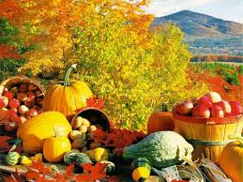
THEME
Goal of
these proposals
Goal of
these proposals
Goal of
these proposals
Proposal
Proposal
Proposal
Proposal
Proposal
Proposal
Proposal
Proposal
Proposal
Proposal
Proposal

Slide 21
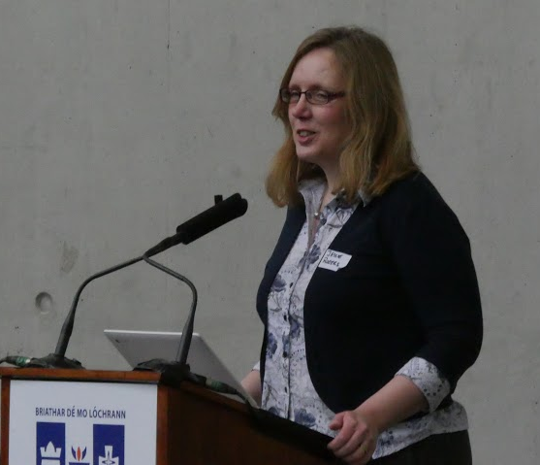
March meeting of delegates
Clarifying the Synod Process, Proposals available to see, Final preparations for Synod

Slide 22
A Synodal process
Gather the delegates
Prepare and send them out
Listen and discern themes
Create Ideas and Proposals

Slide 23
A Synod Process
Gathering, listening, learning, planting, harvesting …

