Slide 1
Gathering of Delegates
3rd October 2015

Slide 2
Listening & Discernment
Data Coding & Analysis
Identifying Themes
Selecting Synod Themes
February to June
Questionnaires, Large Gatherings, Focus Groups, Informal Listening
July to mid September
Data coding, analysis
and collation
Recap of the process to date
Mid to end September
Identification of long list
of Synod themes
3rd October (today!)
Selection of themes to go forward to the Synod

Slide 3
Review of the Synod
Listening & Discernment Process
Data Coding and Analysis
Identification of Synod Themes

Slide 4
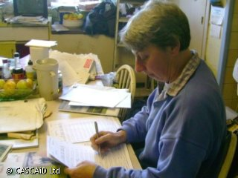
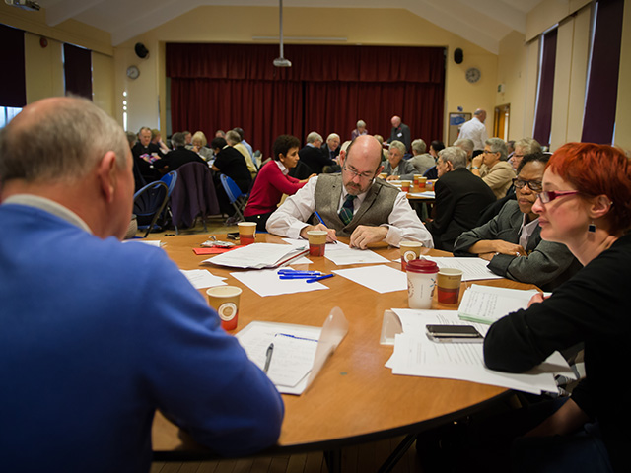
Synod Listening & Discernment Process
Who participated?
All 60 parishes
25 other groups including, primary, secondary and third level education, traveller community, healthcare, Polish community, Irish speaking community, Fair Trade, People with Disabilities, social workers, Lourdes groups, Muintearas and several faith related and religious groups
>1,500 participated in large gatherings and small group discussions
>4,000 filled in questionnaires

Slide 5
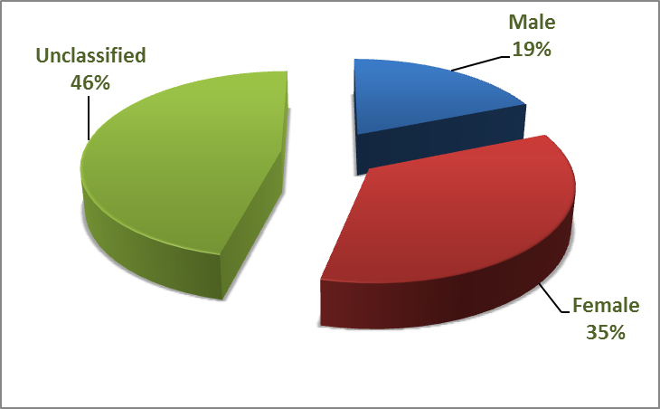
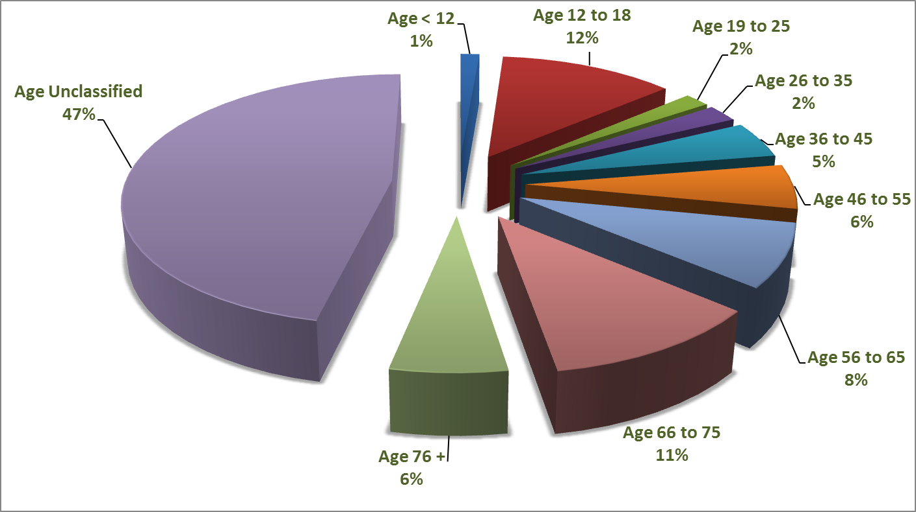
Gender profile
Age profile

Slide 6
Handling the data -
‘Fishbowl’ Training
Sr. Betty Baker
Rosemary O’ Connor
Jean O’Rourke
Mary O’ Brien
Nuala Kernan
Research
experts
Jessie Rogers
Niamh Hourigan
Fr. Eamonn Fitzgibbon
Sr. Margaret O’ Sullivan
Bishop Donal Murray
John Weafer
Anthony O’ Carroll
Fiona Dineen
Fr. Gerry Clarke S. J
Eugene Duffy
Fr. Sean Harmon
Donal Fitzgibbon
Fr. John O’ Shea
Geraldine Hanna
Noirin Lynch
Carmel Plant
Data analyst group

Slide 7
Data sampling
Questionnaires , large assembly reports, small group reports etc. were grouped into datasets by parish and other groupings…
Parishes
Dataset
Social Partners Dataset
Education
Dataset
Other Groups Dataset
The data analyst group, working in pairs, took a ‘cross slice’ sample of data from across all datasets to determine a
data coding framework
to organise the data…

Slide 8
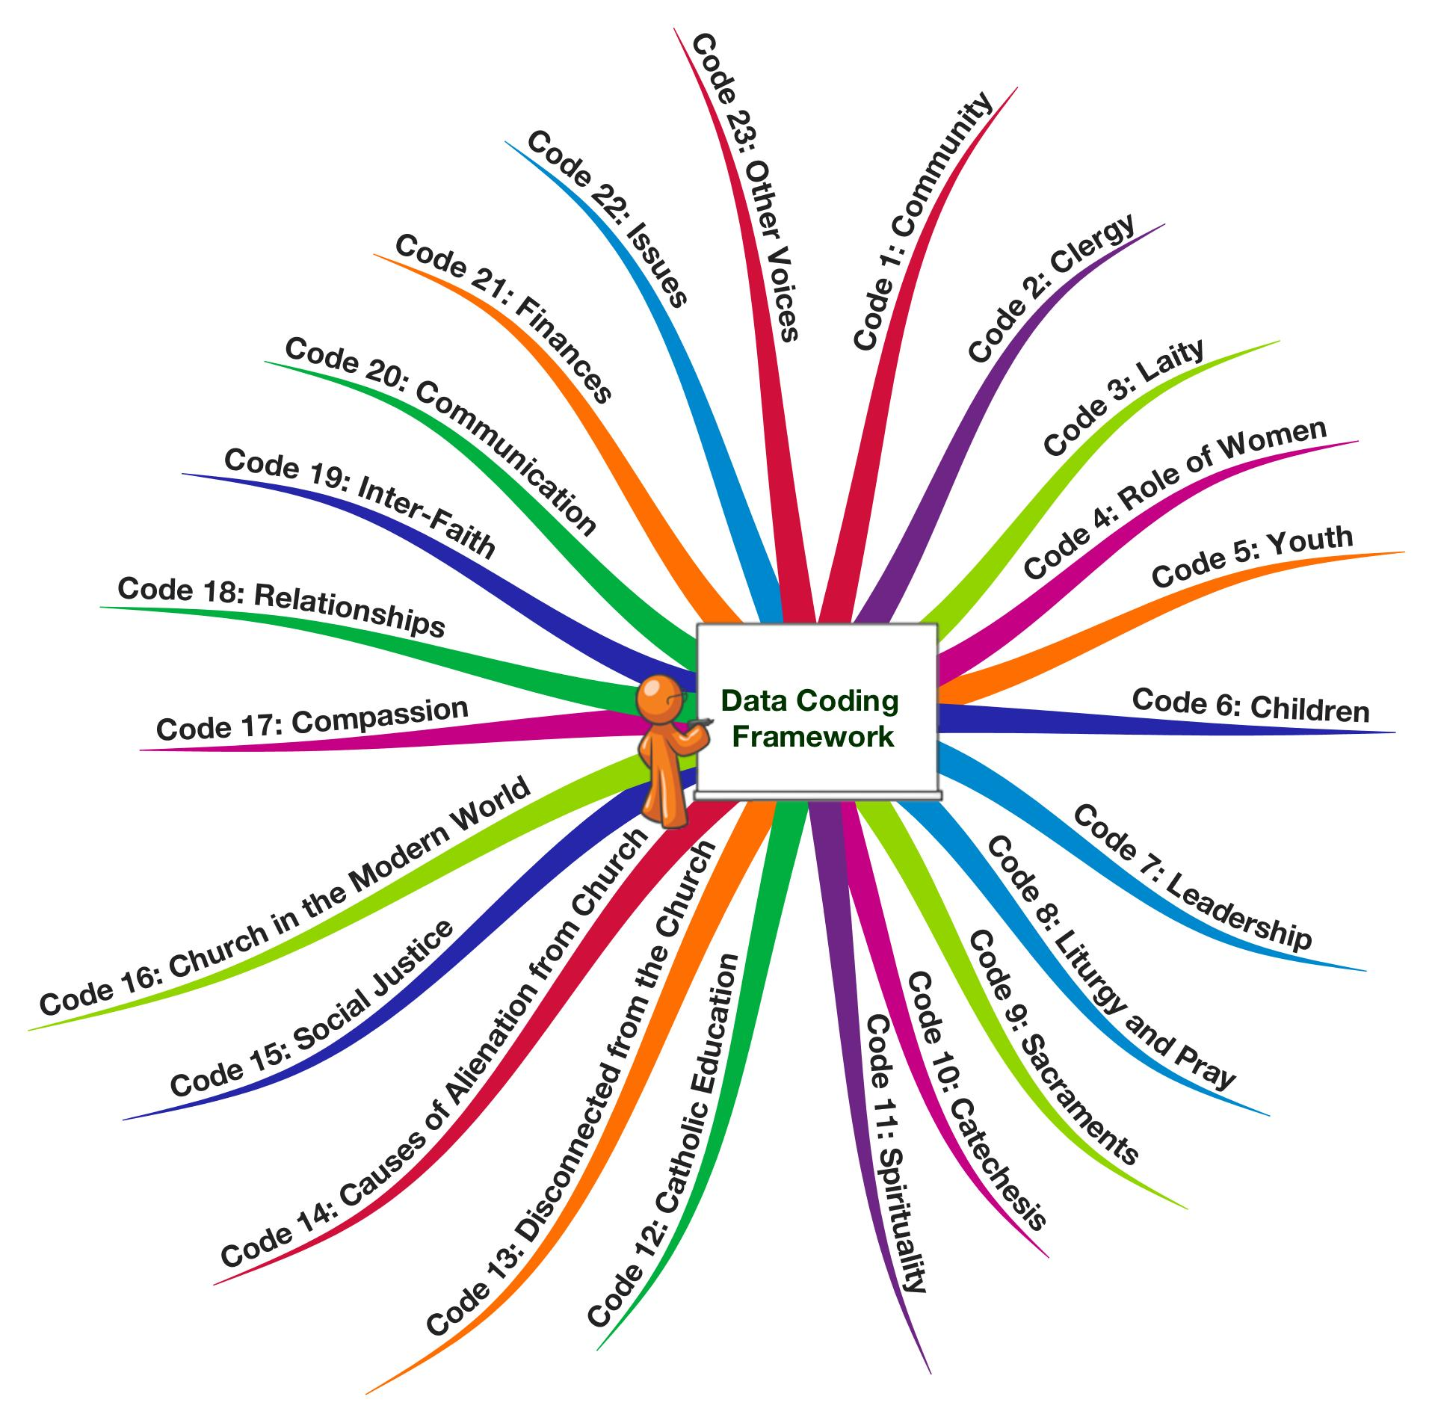
Data coding framework with 23 Codes

Slide 9
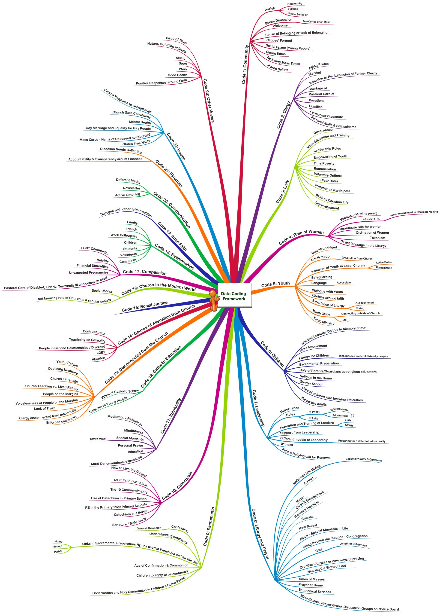
Data coding framework with 23 codes and 153 sub-codes

Slide 10
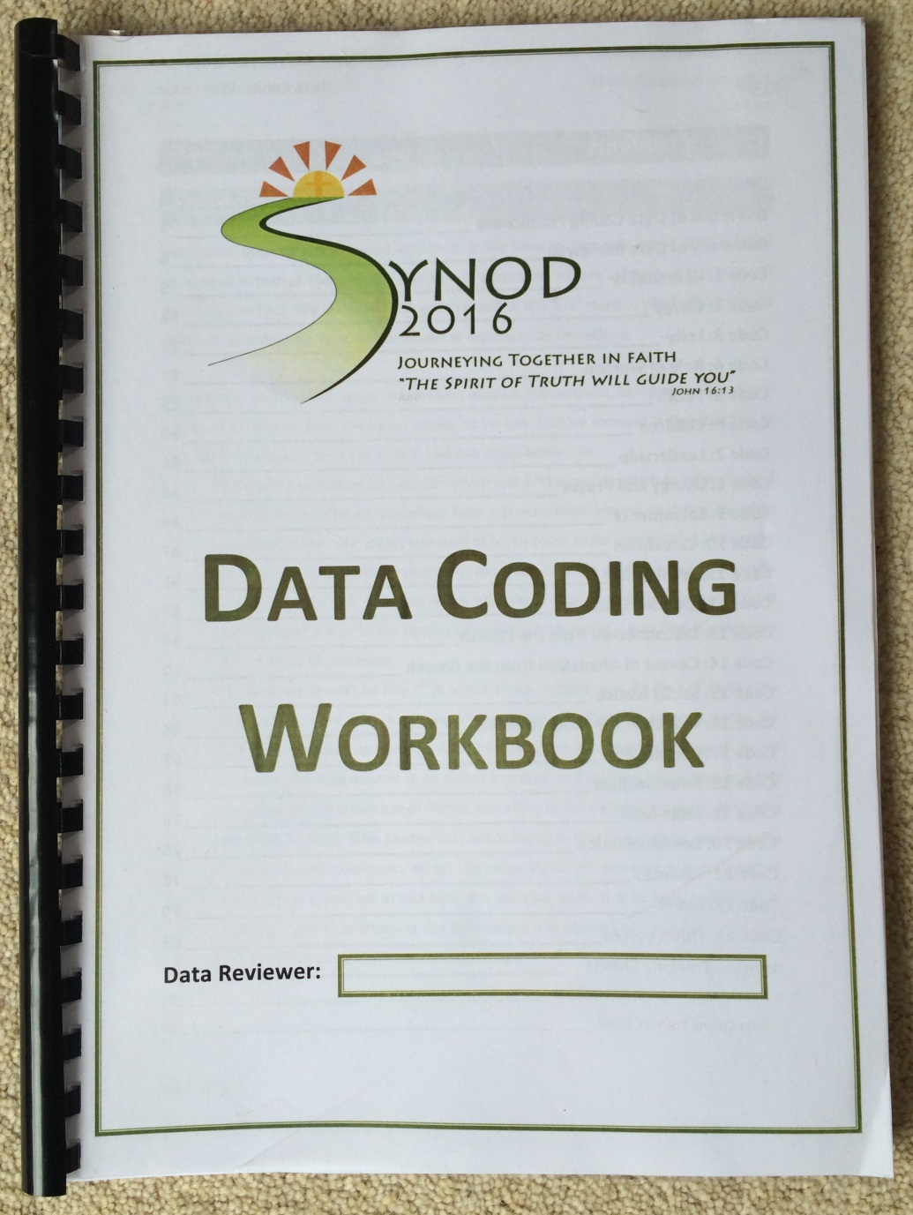
A Data Coding Workbook
was developed and used by the data analyst team to code the data and extract key quotations (qualitative data) over the summer period …

Slide 11
Moving from ‘codes’ to ‘themes’
A code is used to label and organise data
A theme presents a phrase or sentence that identifies what the data means
Other groups data
Parish data
Social partner data
Synod (themes)
This involved an analysis and sieving of the coded data to arrive at a set of themes

Slide 12
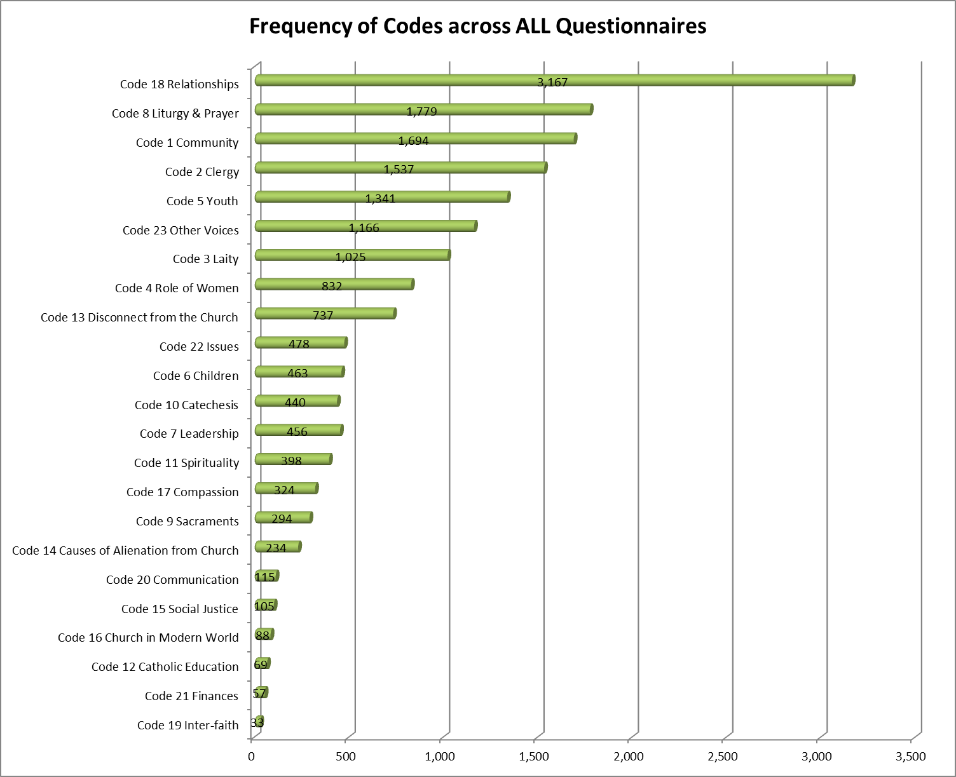
Collation of Data
All data sets were collated and analysed
A ranked list of codes and sub-codes was produced
The qualitative and quantitative data was reviewed from which the list of themes emerged

Slide 13
Parish data
Social partner data
Other groups data
Care for the Earth
Community and Sense of belonging
Faith Formation / Education / Catechesis
Healing Hurts
T hemes
Liturgy and Life
Ministry Roles
New Models of Pastoral Leadership – Facing the New Reality
Pastoral Care of the Family
Spirituality and Ways of Praying
Social Justice
Women in the Church
Young People

