Slide 1
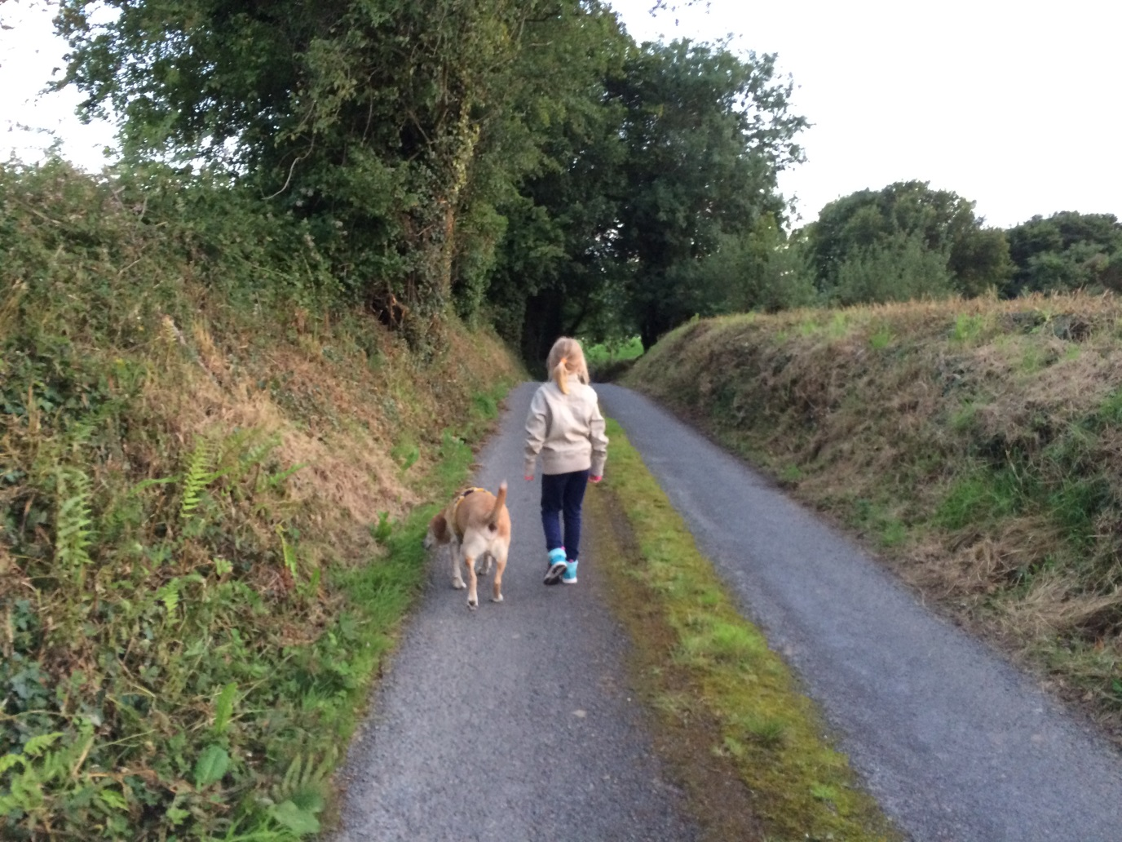
Theme 1 – Care of the Earth
Care of our common home (Pope Francis)
Unconditional love of animals/pets
God in nature

Slide 2
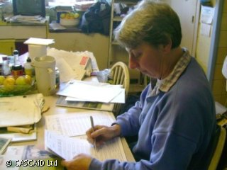
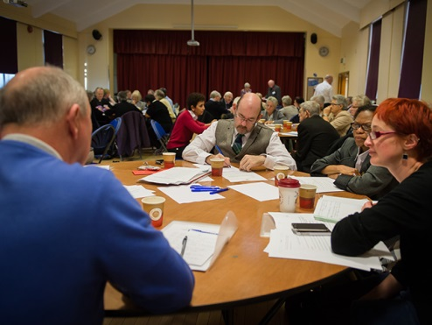
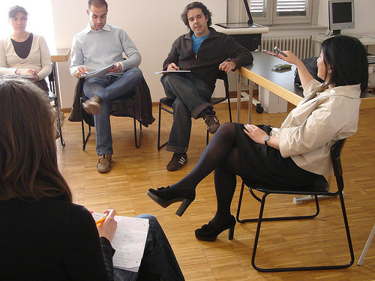
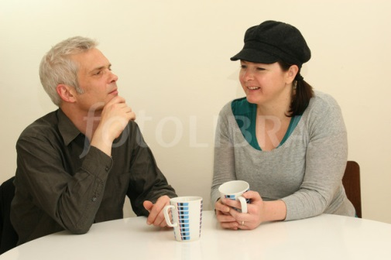
Theme 1 – Care of the Earth cont.
Who has talked about Care of the Earth?
Groups that spoke about this theme were parishes, children, teenagers, third level, and religious groups.
Nature and animals were named very often as a source of finding truth, love, joy, hope – finding God’s love.
Laudato si’, Pope Francis’ encyclical invites all of us to contemplate creation to “discover in each thing a teaching which God wishes to hand on to us” (Laudato si, 85)
Questionnaires
Large Groups
Small Groups
Informal Listening
281 mentions
27 mentions
15 mentions
3 mentions

Slide 3
Theme 1 - Care of the Earth cont.
“When I sit in stillness. When I'm in nature”
“ In the unconditional love of my dog” (where I experience God’s presence/love)
“I find joy in the sun, the moon, the stars, animals and nature”
“God is everywhere from the working of human body, to nature, to each little miracle”
What are people saying?
“Living our vocation to be protectors of God’s handiwork is essential to a life of virtue; it is not an optional or a secondary aspect of our Christian experience”
(Laudato si’, 217)
“The ultimate purpose of other creatures is not to be found in us. Rather, all creatures are moving forward with us and through us to a common point of arrival, which is God” (Laudato si’, 83)

Slide 4
Theme 2 - Community & Sense of Belonging
Social
gatherings
Declining numbers
Building community
Lack of belonging
Volunteers
Cliques
Caring ethos

Slide 5
Theme 2 - Community & Sense of Belonging cont.
Who has talked about Community & Belonging?
Community and Belonging is the second most popular topic in the listening
Mentioned across parishes and other groups such as the Polish community and Fair Trade
Particularly evident in the Traveller community, people with disabilities and third level students
Questionnaires
Large Groups
Small Groups
Informal Listening
3,689 mentions
355 mentions
180 mentions
19 mentions

Slide 6
Theme 2 - Community & Sense of Belonging cont.
“I see neighbours supporting each other through good times and bad, the elderly who are cared for in their own homes and the friendships of friends, neighbours and relations. I feel I am not alone.”
“The community is doing excellent work – many people are giving of their time”
“Be inclusive and invite people to join in, all parishioners should be seen and acknowledged … the born and bred locals have all the clout”
What are people saying?
“The Church must be seen to be more involved with the community always and not just special occasions”
“Because young children are made to feel welcome in our parish young parents continue to come to the Church”
“Unconditional welcome to all regardless of marital status, sexual orientation etc.”

Slide 7
Theme 3 – Faith Formation / Education / Catechesis
Church teaching versus lived reality
Adult faith formation
Sacramental preparation
Scripture / bible study
Home / School / Parish links
How to live the Gospel
RE in schools
Confession
(General Absolution)

Slide 8
Theme 3 – Faith Formation / Education / Catechesis cont.
Who has talked about Faith Formation ...?
The biggest topic is reconciling Church teaching versus lived reality. This is particularly evident in responses from young people (schools, colleges, Lourdes) as well as people with disabilities and those in healthcare.
Adult Faith Formation and Religious Education are also key topics across parishes and young people.
Questionnaires
Large Groups
Small Groups
Informal Listening
1,437 mentions
196 mentions
169 mentions
21 mentions

Slide 9
Theme 3 – Faith Formation /Education / Catechesis cont.
“Need a different approach for young people …older people are different, they have the tradition of faith and prayer. Need to chat with young people to see what are they interested in - need light hearted approach”
“To examine relations between home, school and parish”
“When people come to know Jesus as a person and share a personal relationship with him our understanding of the Church becomes clear”
What are people saying?
“Most people lead good lives – how can they be helped link their daily lives to their faith and their faith to daily lives”
“Our religious teaching in schools is under threat. If this is allowed to happen it will be detrimental to future generations”
“Faith is not an adult faith which can help people cope with real difficulties”

Slide 10
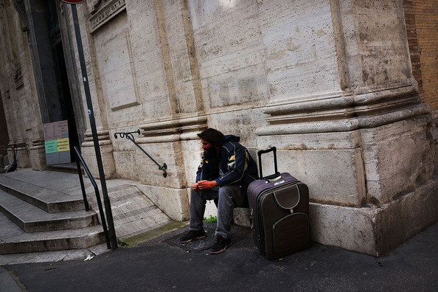
Theme 4 – Healing Hurts
Church response to wrongdoings
Mental health
LGBT community
Issue of trust
Suicide
Abortion
Financial Difficulties

Slide 11
Theme 4 – Healing Hurts cont.
Who has talked about Healing Hurts?
The Church’s response to wrongdoings is the topic raised most often in this theme. This is particularly evident across parishes and in responses from young people (schools, colleges, Lourdes) as well as groups such as the Irish speaking community
The need for a compassionate response to the LGBT community and those affected by abortion and suicide also feature strongly.
Mental health is a particular issue for young people and groups such as the Traveller community
Questionnaires
Large Groups
Small Groups
Informal Listening
412 mentions
90 mentions
34 mentions
2 mentions

Slide 12
Theme 4 – Healing Hurts cont.
“I am dissatisfied by the way the church abused its power and allowed abuse to go on by not dealing in a satisfactory way with those involved”
“Did God not make me? He made me gay so I don’t have a home”
“Suicide is an epidemic and with 2 young children it worries me what kind of future they will have in a world full of pressure, cyber activity and worries...”
What are people saying?
“Mental health is a very serious issue of our time – the church can do more”
“I would like to gently mention that my God does not discriminate on colour, sex or sexual orientation”
“The church must be kinder and more considerate”

Slide 13
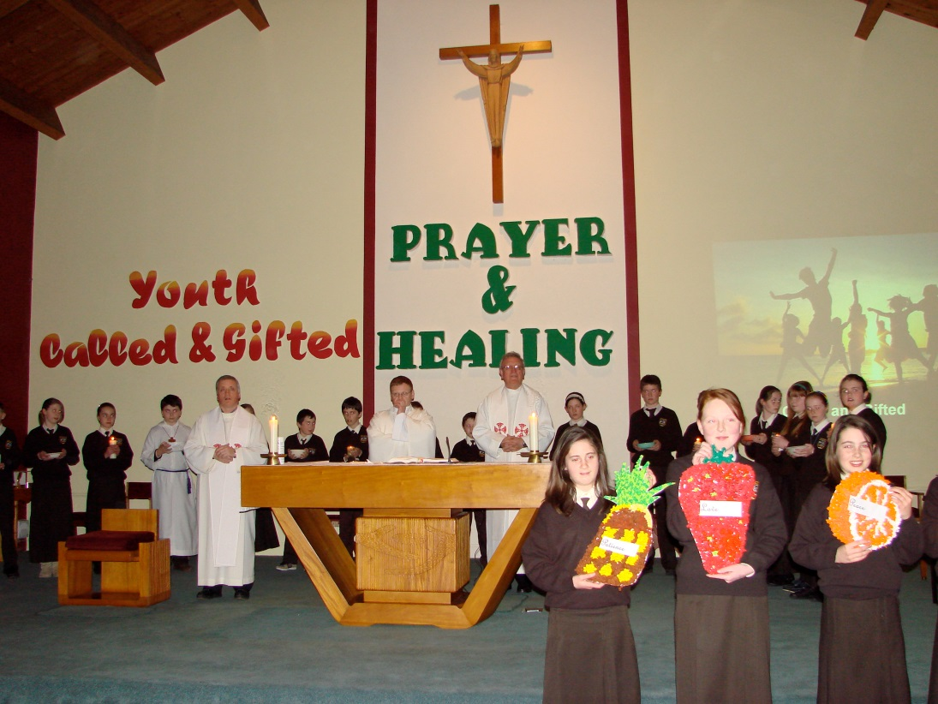
Theme 5 - Liturgy & Life
Joyful & life-giving
Child-friendly
Homilies
Ritual – special moments
Hearing the word of God
Creative liturgies
Music

Slide 14
Theme 5 - Liturgy & Life cont.
Who has talked about Liturgy?
Meaningful, joyful liturgy is of concern across all groups
Music in liturgy is the highest ranking topic in the Liturgy theme; particularly evident in secondary students, third level students and active Church groups
Language in liturgy is also a concern and was named as such by the Irish speaking community
The Church environment is particularly important to people with disabilities and the traveller community
Questionnaires
Large Groups
Small Groups
Informal Listening
2,606 mentions
299 mentions
197 mentions
70 mentions

Slide 15
Theme 5 - Liturgy & Life cont.
“I attend Mass because I enjoy it – lovely priest and great community spirit”
“Attending weekly Mass and the choir - great joy in singing”
“Little or no understanding of issues for ordinary people” (homilies)
“Nothing encourages me, no sense of occasion anymore, no feeling of joy or enlightenment after Sunday Mass”
What are people saying?
“People don’t connect with something because it doesn’t relate to their lives”
“The sheer joy of being in God’s presence in the stillness of the Church and his presence everyday as I go about my life”
“A revamp of communicating the message of the gospel of Jesus Christ”

Slide 16
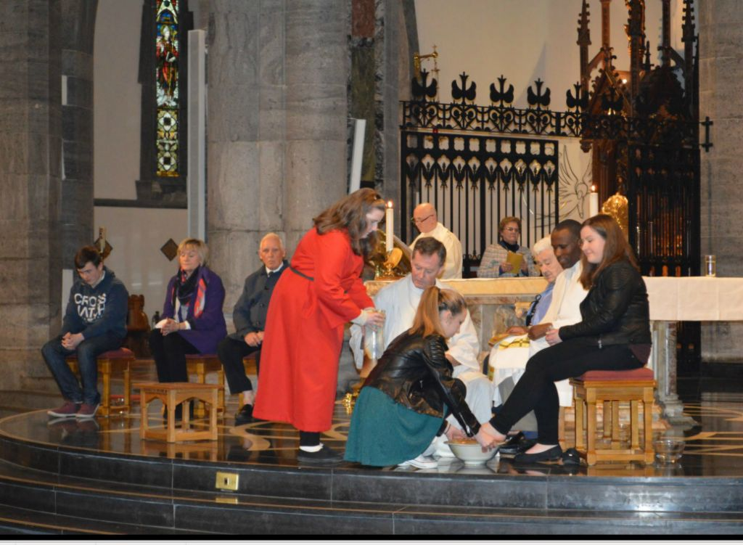
Theme 6 – Ministry Roles
Active roles for children and young people
Invitation to participate
Education & training
Empowerment of Laity
Voluntary options
Time Poverty
Clear roles

Slide 17
Theme 6 – Ministry Roles cont.
Who has talked about Ministry Roles?
The inclusion of young people and lay involvement are the highest ranking concerns in this theme.
Particularly evident in parishes, and also among teenagers and children
Questionnaires
Large Groups
Small Groups
Informal Listening
1,604 mentions
161 mentions
74 mentions
13 mentions

Slide 18
Theme 6 – Ministry Roles cont.
“I want to see a vibrant church to continue for the generations to come – the depleted clergy cannot cope without help from the laity”.
“Not active – never been asked”
“Consider what members of the laity can bring to the Church both in liturgy and the wider life of the Church”
What are people saying?
“Good sound parish organisation – priests, pastoral councils, Eucharistic ministers etc.”
“Practical training programmes to ensure that clergy and laity are properly prepared. Ongoing supervisory systems to ensure accountability and professional practice.”
“Involve younger people where possible – give them responsibility”

Slide 19
Theme 7 - New Models of Pastoral Leadership; facing the new reality
Accountability
Finance
Role of women
Role of laity
Role of clergy
Shortage of clergy
Spiritual leadership
Communications
Vocations
Governance

Slide 20
Theme 7 - New Models of Pastoral Leadership cont.
Who has talked about Leadership?
The need for new, skilled leadership models was particularly evident in parishes and third level students
Personal skills of pastoral leaders, the shortage of vocations, married clergy and the role of women in leadership are the highest ranking issues under the theme of leadership.
Questionnaires
Large Groups
Small Groups
Informal Listening
2,451 mentions
265 mentions
170 mentions
19 mentions

Slide 21
Theme 7 - New Models of Pastoral Leadership cont.
“More involvement of the lay leaders of the Church in its daily running”
“Meaningful roles with responsibility, not lip service”
“Often priests’ role is taken for granted”
“With the absence of any kind of pastoral group in the community how can we prepare for a future without a priest?”
What are people saying?
“Women have been carrying the Church for many generations without formal recognition or thanks”
“I would like to see the shortage of priests addressed with positive action rather than an expression of impending doom”
“The question of parish finances need to be reviewed and discussed”

Slide 22
Theme 8 - Pastoral Care
of the Family
Role of parents /
guardians in passing on the faith
Caring for children
Caring for elderly/sick
Gay marriage, equality for gay people
Family relationships
Separation / Divorce
2nd relationships

Slide 23
Theme 8 - Pastoral Care of the Family cont.
Who has talked about Family?
Family is the single highest ranking topic across all the listening
Mentioned across parishes and all other groups
Particularly evident in primary, secondary and third level groups
Questionnaires
Large Groups
Small Groups
Informal Listening
2,225 mentions
170 mentions
89 mentions
13 mentions

Slide 24
Theme 8 - Pastoral Care of the Family cont.
“As a parent of young children faith is important to me. I want to hand that faith on to my children. By bringing them to the local Church I can instil faith/beliefs in their life.”
“Ways to make the Church more a part of family life”.
“Why is the official Church not showing the love it preaches about especially towards gay people who have suffered so much?”
What are people saying?
“Family and especially divorced and the way the Church doesn't welcome them”
“In my own home and family I have the love and respect of my own family – they are all good citizens even though they are not all good church goers.”
“Provide help and support for children of separated and divorced families”

Slide 25
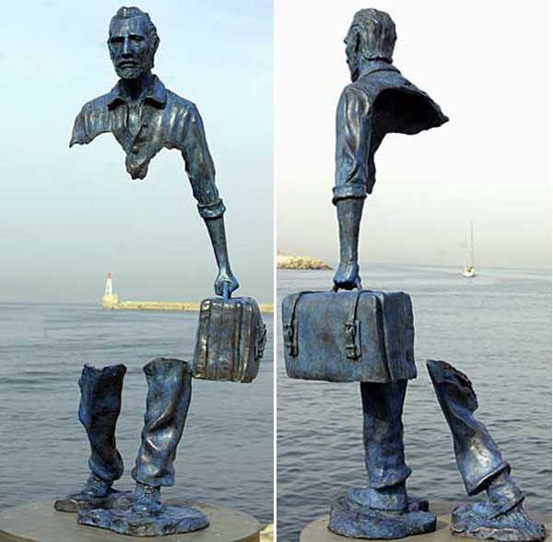
Theme 9 – Social Justice
People on the margins
Voiceless-ness of people on the margins
Social Justice
Wellbeing
Poverty
Safety
Outward migration

Slide 26
Theme 9 – Social Justice cont.
Who has talked about Social Justice?
Social Justice for People on the margins was discussed across parishes, by young people (teenagers, Lourdes) and groups such as people with disabilities and religious groups.
The voiceless-ness of those on the margins was raised as a specific issue.
Questionnaires
Large Groups
Small Groups
Informal Listening
248 mentions
37 mentions
14 mentions
3 mentions

Slide 27
Theme 9 – Social Justice cont.
“The real-life concerns of the people … poverty/austerity, sense of safety and wellbeing, outward migration of over half the population, housing conditions …situation of children, voicelessness / powerlessness.”
“A pro-active approach to new immigrants”
“The church has to be seen as an organisation that is there to help the poor and discouraged – it has to work hard to be socially inclusive”
What are people saying?
“The Church is missing the point within the terrible tragedy of drugs and young people”
“Church of service – need for outreach; how can we be a Church who serves? … Inclusion of the marginalised is not always reflected in what we are doing”
“How are we caring for the poor and marginalised – do we know who they are?”

Slide 28
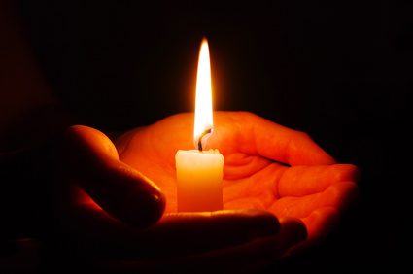
Theme 10 – Spirituality & Ways of Praying
Multi-denomination experience
Meditation
Special moments
Personal Prayer
Mindfulness
Adoration
Reflection

Slide 29
Theme 10 – Spirituality & ways of praying cont.
Who has talked about Spirituality?
Personal prayer is the highest ranking topic in the Spirituality theme, noted particularly across parishes and groups such as the Traveller community
An appreciation of the value of meditation featured strongly amongst children, the healthcare sector and third level students
Adoration was cited as a positive faith experience across parishes
Questionnaires
Large Groups
Small Groups
Informal Listening
398 mentions
52 mentions
39 mentions
4 mentions

Slide 30
Theme 10 – Spirituality & ways of praying cont.
“I see God in the centre of my life I could not go on this earth without believing he is with me at all times. It gives me great hope”
“I find prayer a great source of fulfilment in my daily life”
“My Mom died of cancer. She never smoked or drank, she was fit and full of life, I prayed God would help her, unfortunately He didn’t hear me….“
What are people saying?
“Reaching out to people who want to embrace their spirituality and making Church a place to do that without the pressure of going to Mass weekly to do so”
“I always pray for peace of mind for myself and for anyone who is troubled. It is the greatest gift and grace to receive”
“I sometimes feel there is no need for me to practise in order to believe”

Slide 31
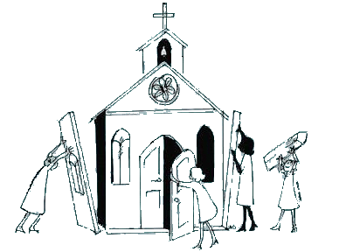
Theme 11 – Women in the Church
Vocation of women
(multi-layered)
Tokenism
Deaconate role for women
Ordination of women

Slide 32
Theme 11 – Women in the Church cont.
Who has talked about Women in the Church?
The vocation of women in the Church was raised across parishes and groups such as the Lourdes group
Ordination of women featured strongly amongst parishes, children, teenagers and third level students
Questionnaires
Large Groups
Small Groups
Informal Listening
617 mentions
67 mentions
33 mentions
3 mentions

Slide 33
Theme 11 – Women in the Church cont.
“I feel women are the backbone of the Church and to see them as ‘second-class’ citizens in the roles they play in the Church is very unfair.”
“The role of women in a meaningful way – not tokenism”
“If you look at the profile of those who participate in the church it is mostly women, yet they have no meaningful role”
What are people saying?
“The role of women in the Church. This is essential for the future 'health' of the Church”
“It is hard to work sometimes when females are being classed as “useful” but not given any or much authority”.
“If in God’s eyes we are all equal, then why not in the Catholic Church”

Slide 34
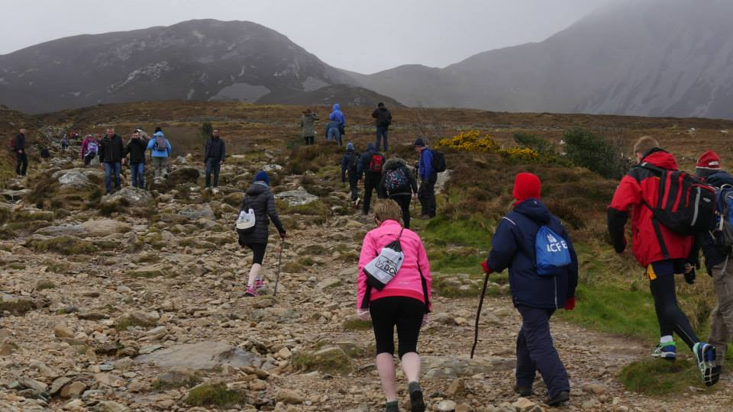
Theme 12 – Young People
Dialogue with young people
Clash of youth activities with mass times
Youth clubs
Disenfranchised
Accessible language
Youth Ministry
Experience of liturgy
Youth Mass

Slide 35
Theme 12 – Young People cont.
Who has talked about Young People?
The engagement and empowerment of young people is of concern across all groups
The disenfranchisement of young people, their negative experience of liturgy and their competing interests are of greatest concern in this theme.
Accessible language is of particular concern to children, teenagers and third level students
Questionnaires
Large Groups
Small Groups
Informal Listening
744 mentions
110 mentions
66 mentions
2 mentions

Slide 36
Theme 12 – Young People cont.
“I like going to mass but it is really boring because the Priest only talks about adult stuff and uses words we don’t understand”
“Youth activities clash with Mass times”
“I don’t like the message that we constantly get at Mass - that life is difficult and that I have to accept this”
What are young people saying?
“I feel let down by the Church due to the things they have done in the past”
“I would like to see the Confirmation class involved in the Sunday readings”
“You should get teenagers in secondary schools to read at mass”
“Youth are searching for God in everyday things”

